Slide 1
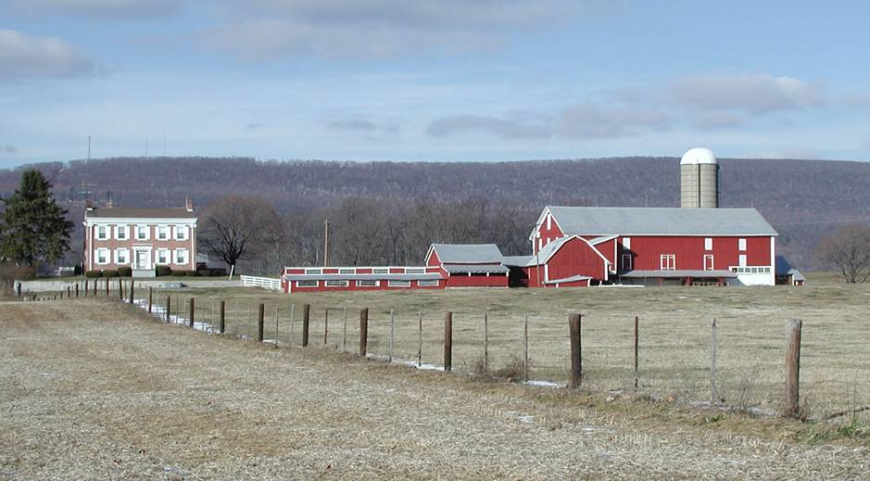
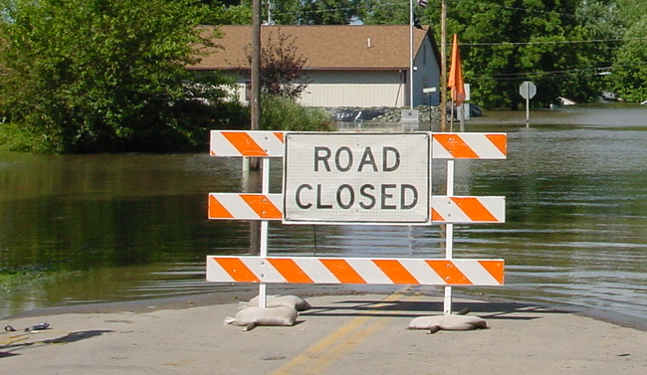

Application Examples of Downscaled Output
ANNE STONER, PhD
Notes:
Photo Source: This work has been released into the public domain by its author, Palnordseth at the Norwegian (bokmål) Wikipedia project. This applies worldwide.

Slide 2
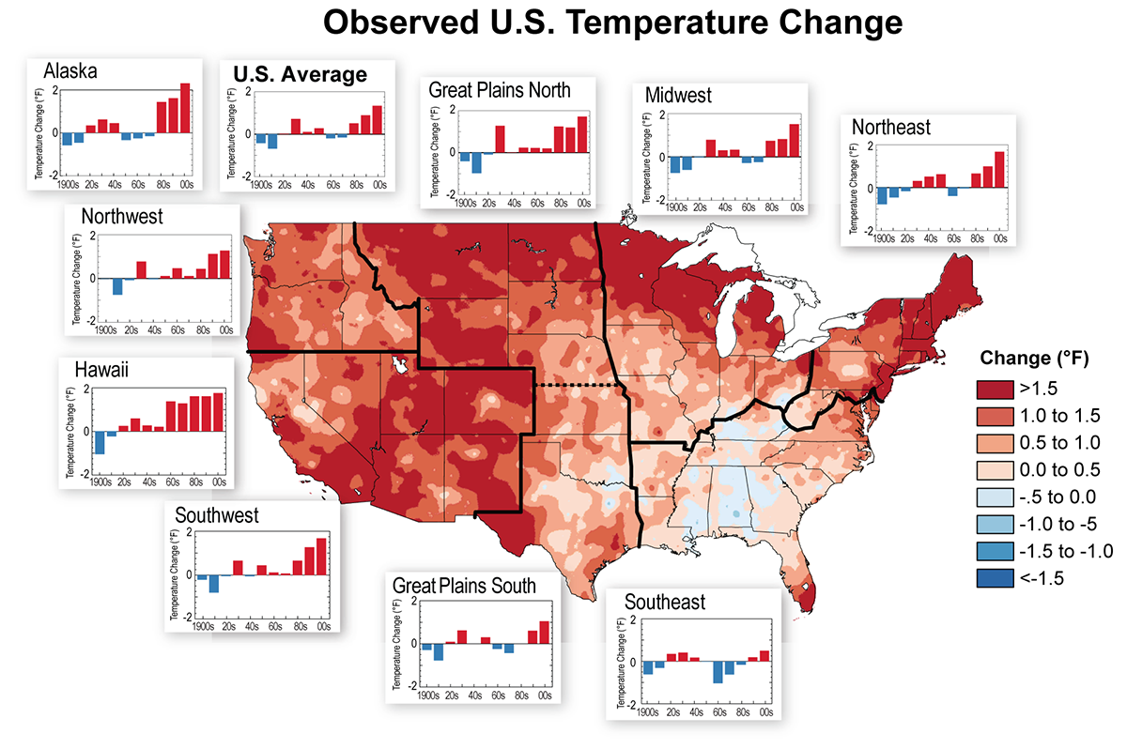
The U.S. is getting warmer
Source: 2014 U.S. National Climate Assessment

Slide 3
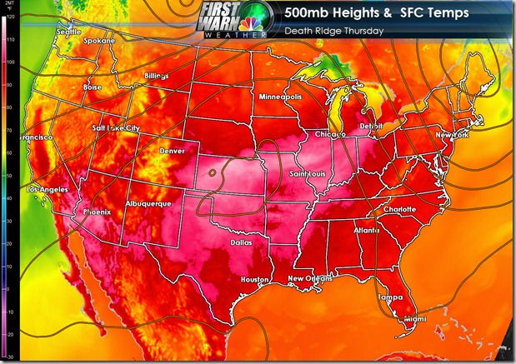
Heat waves are stronger and more frequent

Slide 4
Regional precipitation patterns have shifted
Source: 2014 U.S. National Climate Assessment
Notes:
The colors on the map show annual total precipitation changes (percent) for 1991-2011 compared to the 1901-1960 average, and show wetter conditions in most areas (McRoberts and Nielsen-Gammon 2011). The bars on the graphs show average precipitation differences by decade for 1901-2011 (relative to the 1901. 1960 average) for each region. The far right bar is for 2001-2011. (Figure source: NOAA NCDC / CICS-NC. Data from NOAA NCDC.)

Slide 5
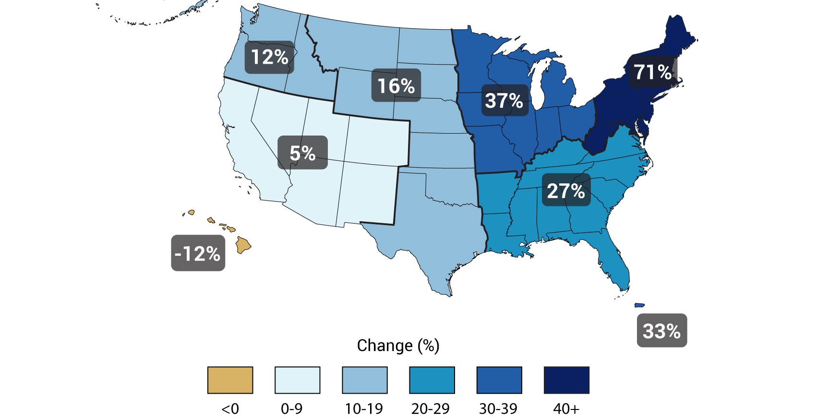
Heavy precipitation becoming more frequent
Notes:
percent increases in the amount falling in very heavy precipitation events (defined as the heaviest 1 percent of all daily events) from 1958 to 2007 for each region. There are clear trends toward more very heavy precipitation for the nation as a whole, and particularly in the Northeast and Midwest.

Slide 6
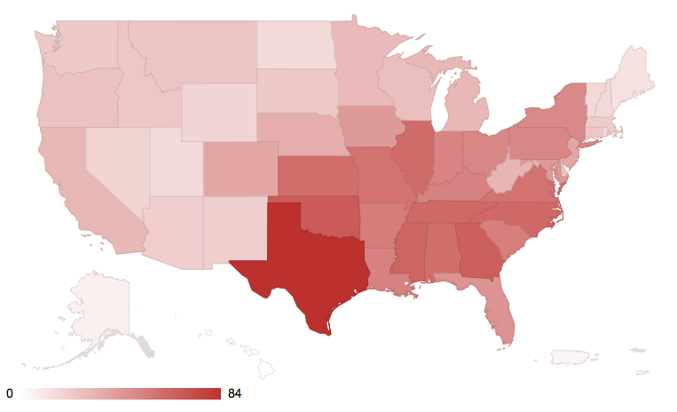
Billion dollar disasters are on the rise
1980-2016 Billion-Dollar Weather and Climate Disasters by State
Source: NOAA National Centers for Environmental Information (2017)
Notes:
The colors on the map show temperature changes over the past 20 years in °F (1991-2011) compared to the 1901-1960 average. The bars on the graphs show the average temperature changes by decade for 1901-2011 (relative to the 1901-1960 average) for each region. The far right bar in each graph (2000s decade) includes 2011. The period from 2001 to 2011 was warmer than any previous decade in every region. (Figure source: NOAA NCDC / CICS-NC. Data from NOAA NCDC. ). Figure 2.6 from Ch2: Our Changing Climate

Slide 7
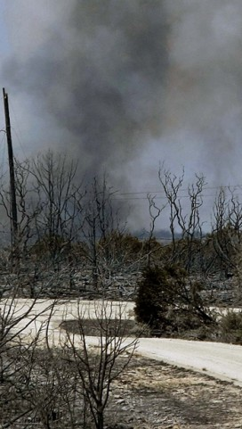
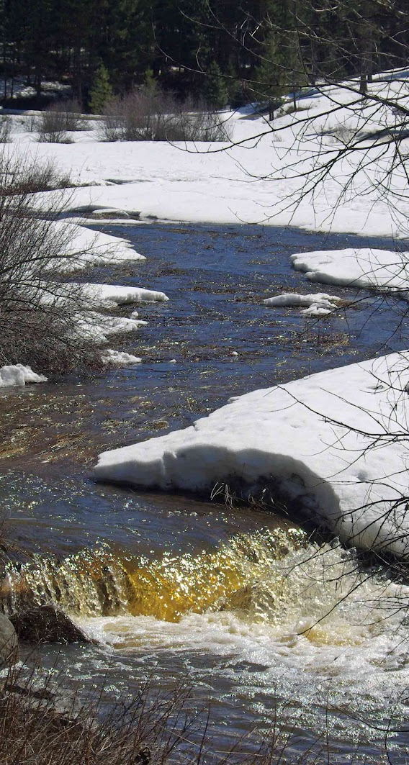
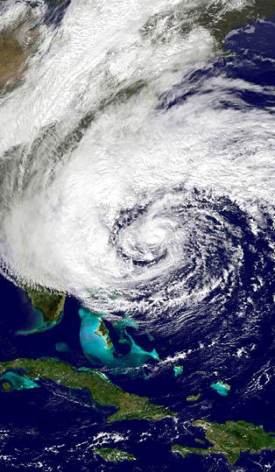

What types of weather events cause these?
Wildfire
Rapid Snowmelt
Hurricanes
Heatwaves

Slide 8
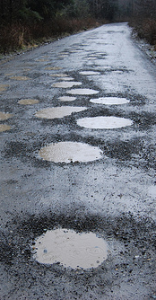
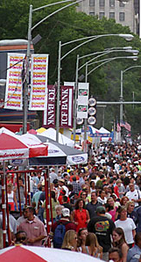

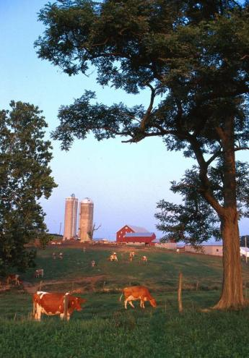
1. How does climate and weather affect our interests?
The first and most important step in any climate impact assessment is to mine available information and knowledge, which includes both existing vulnerabilities and historical events.
Infrastructure
Maintenance
Tourism
Public Health
Agriculture

Slide 9
2. What can climate science reliably tell us?
The second step in any climate impact assessment is to consider the extent to which robust quantitative projections can be developed.
Specifically:
Is the relationship between climate indicators and relevant infrastructure or other impacts clear?
Are there historical trends in these indicators?
Are climate models able to reproduce the observed historical trend?
Can future trends be quantified, or does the noise outweigh the signal?

Slide 10
3. Data, Model Output, and Methods
To answer the questions posed in the second step, we need to simultaneously complete a third step: assembling available data and information. This includes:
Daily temperature, precipitation, and humidity (dewpoint) observations for several weather stations

Slide 11
3. Data, Model Output, and Methods
To answer the questions posed in the second step, we need to simultaneously complete a third step: assembling available data and information. This includes:
Daily temperature, precipitation, and humidity (dewpoint) observations for several weather stations
Daily projections from a collection of climate models

Slide 12
3. Data, Model Output, and Methods
To answer the questions posed in the second step, we need to simultaneously complete a third step: assembling available data and information. This includes:
Daily temperature, precipitation, and humidity (dewpoint) observations for several weather stations
Daily projections from a collection of climate models
Use at least a higher and lower future scenario to cover the range in projected climate

Slide 13
3. Data, Model Output, and Methods
To answer the questions posed in the second step, we need to simultaneously complete a third step: assembling available data and information. This includes:
Daily temperature, precipitation, and humidity (dewpoint) observations for several weather stations
Daily projections from a collection of climate models
Use at least a higher and lower future scenario to cover the range in projected climate
Use an empirical statistical downscaling model capable of resolving changes in mean and extreme values or use output from a regional climate model if available

Slide 14
3. Data, Model Output, and Methods
To answer the questions posed in the second step, we need to simultaneously complete a third step: assembling available data and information. This includes:
Daily temperature, precipitation, and humidity (dewpoint) observations for several weather stations
Daily projections from a collection of climate models
Use at least a higher and lower future scenario to cover the range in projected climate
Use an empirical statistical downscaling model capable of resolving changes in mean and extreme values or use output from a regional climate model if available
Calculate relevant climate indices or apply an impact model

Slide 15

Urban planning for Washington D.C.
City planners and officials in Washington D.C. are worried about the recurrence of the 2012 heat wave
  11 consecutive days with Tmax > 35°C
  1 day with Tmax > 40°C

Slide 16
Procedure
Downscaled 9 CMIP5 GCMs
3 local weather stations for 1950-2100
2 future scenarios (RCP4.5, RCP8.5)
4 daily variables (min/max temperature, precipitation, humidity)
Calculated suite of climate indicators tailored to concerns

Slide 17
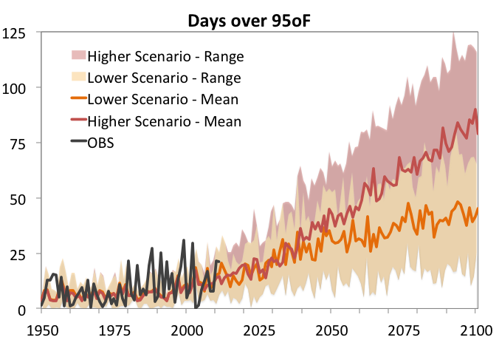
Will the 2012 heat wave recur?
Days/yr over 35°C

Slide 18
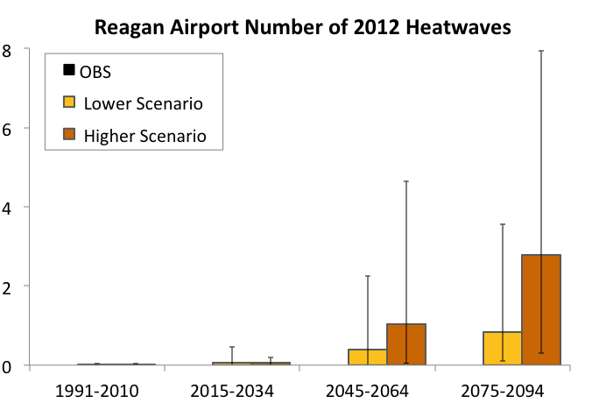
Will the 2012 heat wave recur?

Slide 19
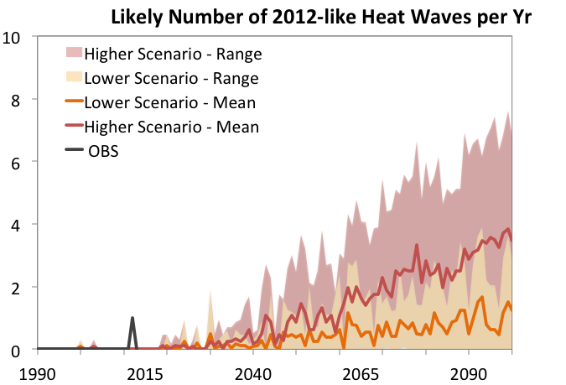
Will the 2012 heat wave recur?

Slide 20
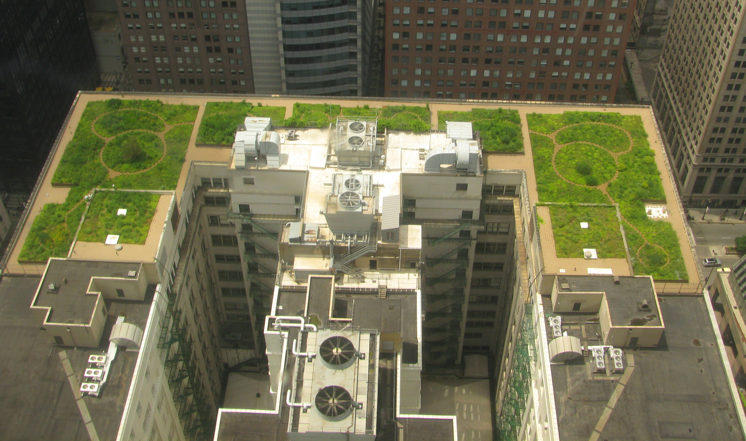
Heat wave prevention

Slide 21
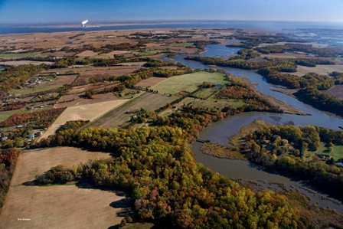
Delaware
Officials in Delaware are worried about flooding events

Slide 22
Heavy precipitation becoming more frequent
Notes:
percent increases in the amount falling in very heavy precipitation events (defined as the heaviest 1 percent of all daily events) from 1958 to 2007 for each region. There are clear trends toward more very heavy precipitation for the nation as a whole, and particularly in the Northeast and Midwest.

Slide 23
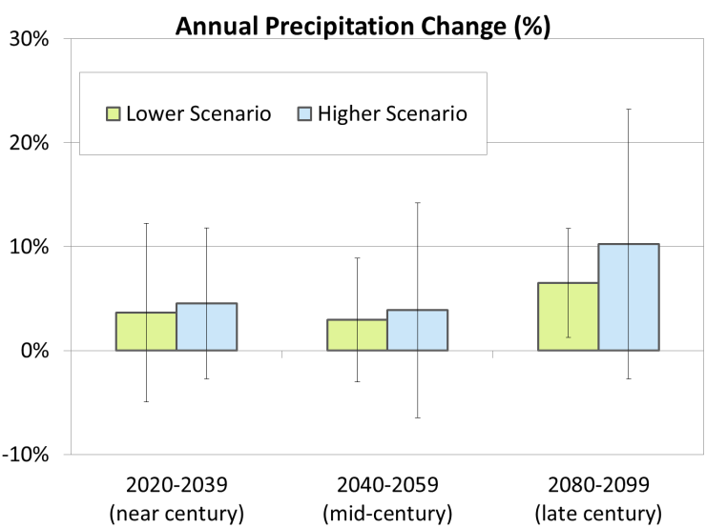
Annual precipitation projected to increase

Slide 24
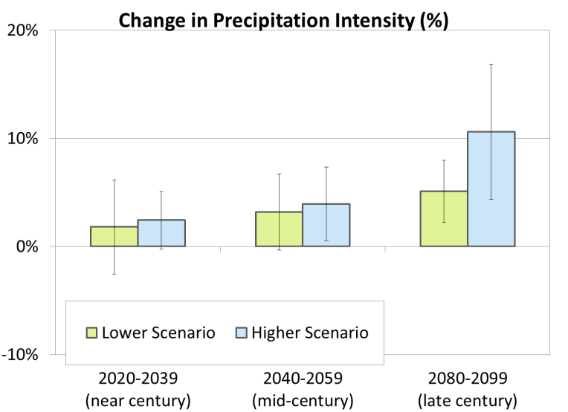
Precipitation becomes more intense

Slide 25
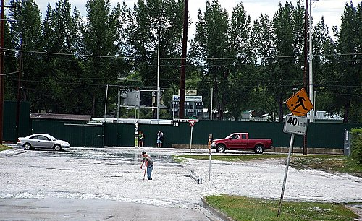
Flood prevention management

Slide 26
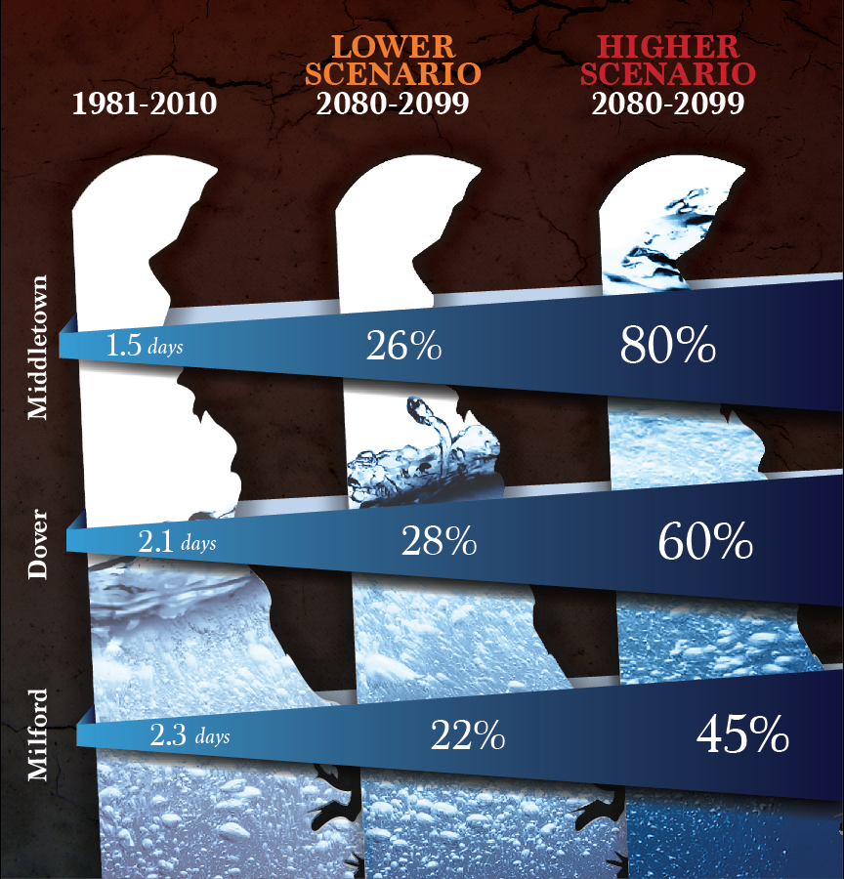
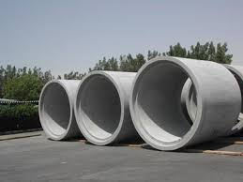
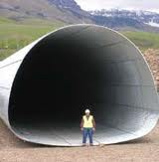
More frequent extreme precipitation

Slide 27
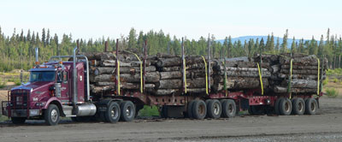
Infrastructure in the Northeast US
Engineers in the Northeast US are worried about climate change affecting the freeze-thaw cycles in roadways, which has implications for the logging business

Slide 28
Roadway sub-surface
Asphalt Surface
Unfrozen Soil

Slide 29
Roadway sub-surface
Asphalt Surface
Frozen Soil
Unfrozen Soil
Winter weight premiums are applied

Slide 30
Roadway sub-surface
Asphalt Surface
Thawed soil; Excess moisture can’t drain down through underlying frozen layer
Critical Period:
Reduced strength & stiffness
Frozen Soil
Unfrozen Soil
Spring load restrictions are applied

Slide 31
Roadway sub-surface frost depth profile
Frost Depth Profile for Madison, ME
Winter 2013/2014
Notes:
When measurements of the subsurface are available it is relatively simple to decide when to apply WWP and SLR, but there are only a limited number of sites where this is measured and we don’t have subsurface profiles everywhere. So instead local DOTs calculate the time of application based on metrics calculated from air temperatures…see next slide.

Slide 32
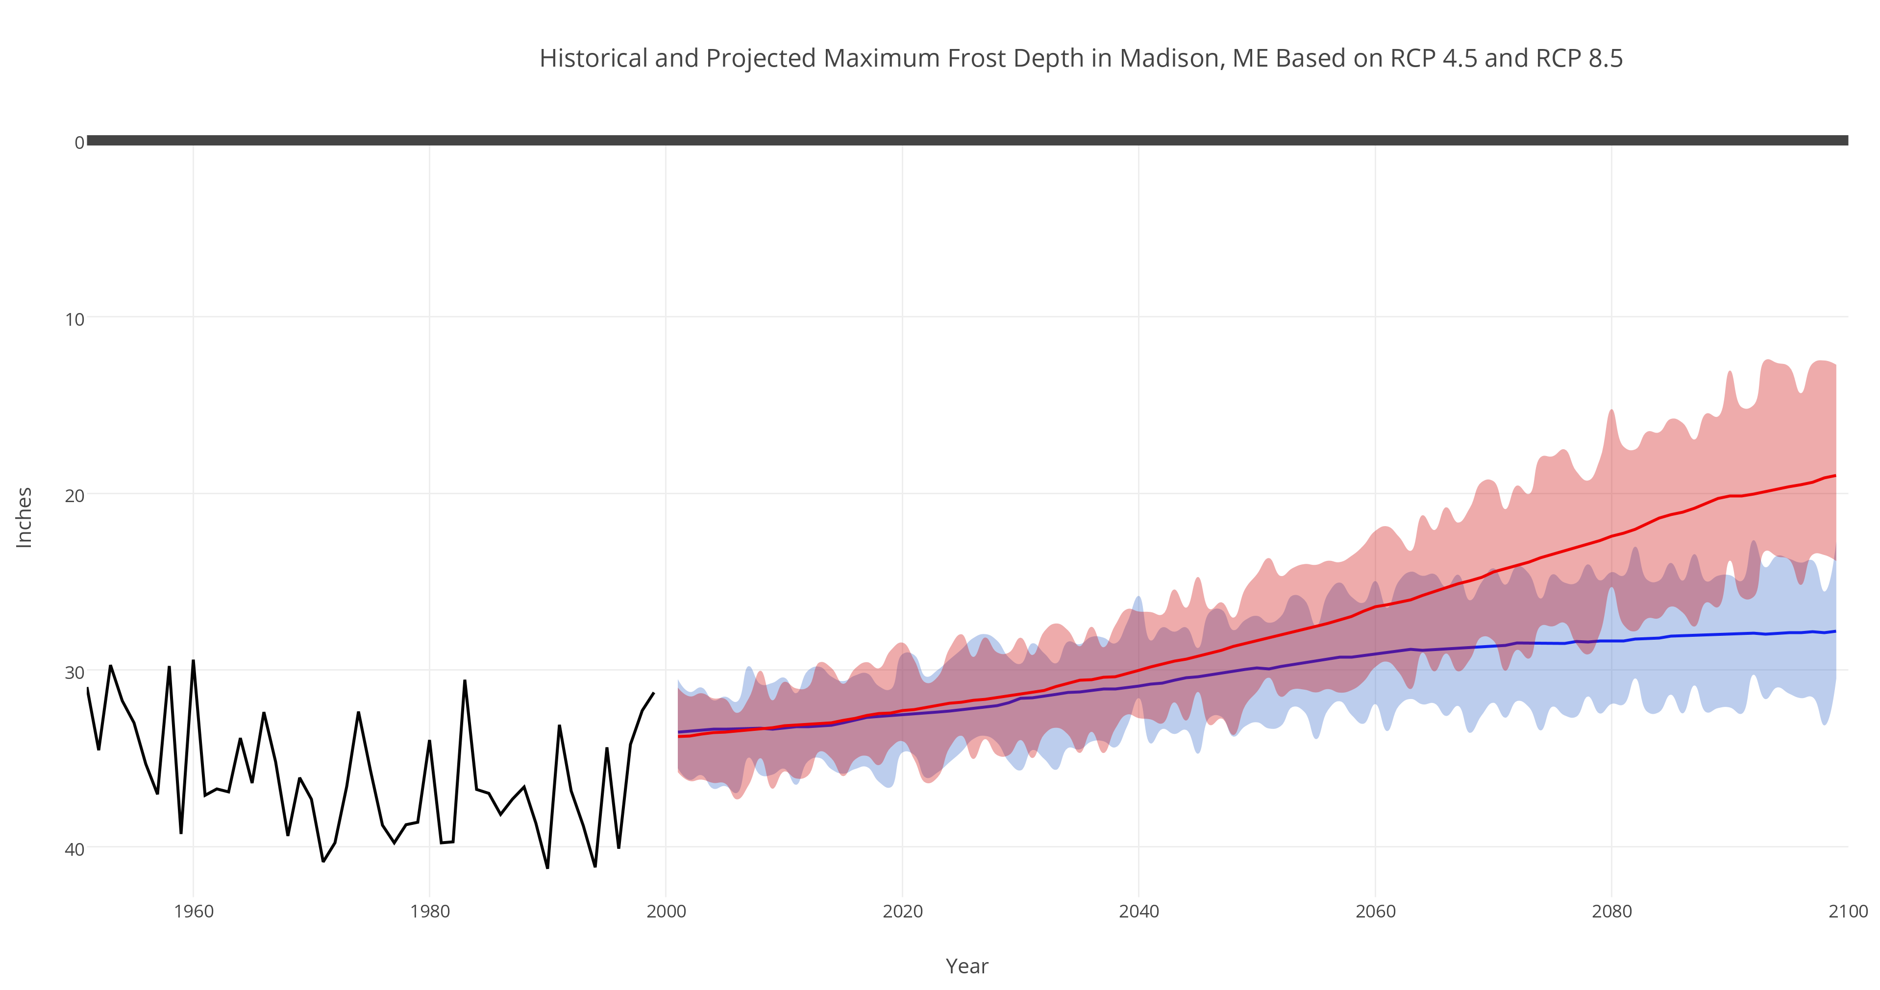
Projected Frost Depth
Historical and Projected Max Frost Depth for Madison, ME
Inches
Year
Notes:
When measurements of the subsurface are available it is relatively simple to decide when to apply WWP and SLR, but there are only a limited number of sites where this is measured and we don’t have subsurface profiles everywhere. So instead local DOTs calculate the time of application based on metrics calculated from air temperatures…see next slide.

Slide 33
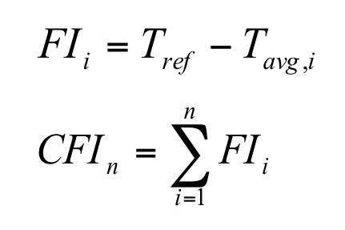
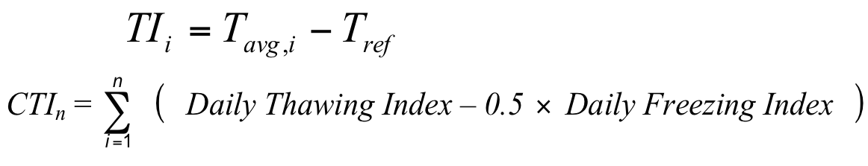
Freezing and Thawing Index
Cumulative Freezing Index (CFI)
  When CFI reaches specific level winter weight premiums are applied
Cumulative Thawing Index (CTI)
  When CTI reaches specific level spring load restrictions are applied

Slide 34
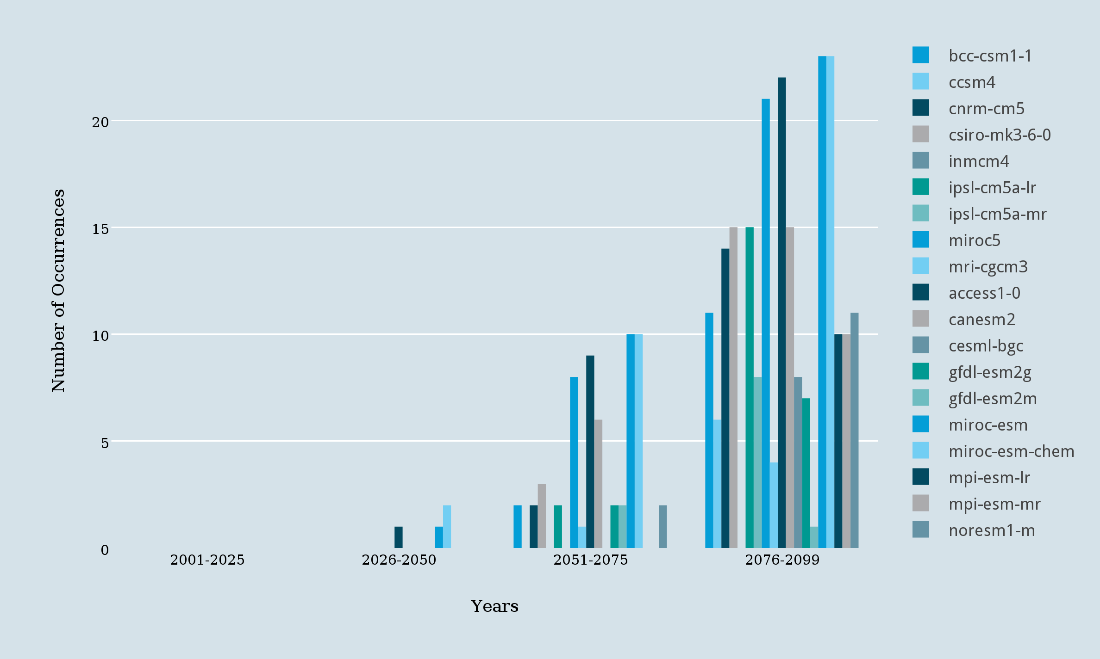
Historical and Projected times CFI threshold is not exceeded for Madison, ME
RCP8.5

Slide 35
Adapting Dairy Farms to Climate Change
People in agriculture are concerned about impacts such as crop yields and quality, animal stress and performance, production costs and profit, and emissions to the environment

Slide 36
Farm System Model
Engine exhaust
Fixed
nutrients
Crop
Harvest
Feed sold
Volatile loss
Storage
Seeding
Grazing
Purchased feed,
bedding, etc.
Volatile loss
Purchased
fertilizer
Runoff &
Leaching loss
Soil
Manure
Animal
Milk and animals
Volatile loss
Exported manure

Slide 37
Farm System Model Output
Crop yields and quality
Milk produced
Resources used (labor, fuel, equipment)
Production costs and profit
Gaseous emissions
Nutrient losses in runoff and leaching

Slide 38
Environmental Footprint
Carbon emissions
Energy use
Water use
Reactive nitrogen loss

Slide 39
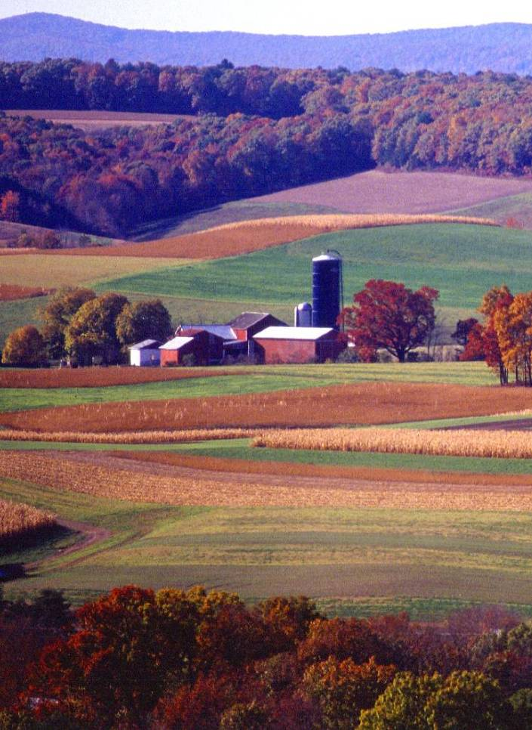
Dairy Farms
Syracuse, NY 1,000 cows, 930 ha
Lancaster, PA 100 cows, 100 ha
Madison, WI 300 cows, 240 ha
Jerome, ID 10,000 cows, 3000 ha
Sacramento, CA 2,000 cows, 320 ha
Stephenville, TX 1,000 cows, 800 ha
Soils and crops were representative of those at each location

Slide 40
Dairy Farms
Syracuse, NY 1,000 cows, 930 ha
Lancaster, PA 100 cows, 100 ha
Madison, WI 300 cows, 240 ha
Jerome, ID 10,000 cows, 3000 ha
Sacramento, CA 2,000 cows, 320 ha
Stephenville, TX 1,000 cows, 800 ha
Soils and crops were representative of those at each location

Slide 41
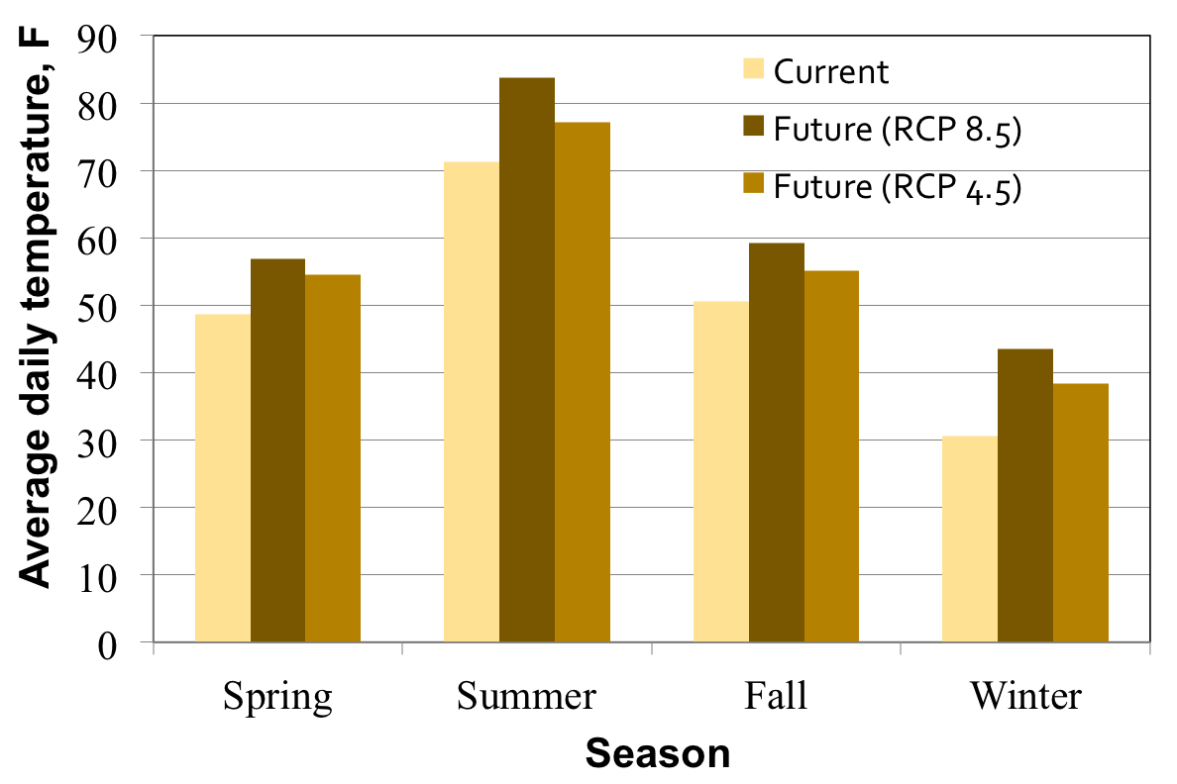
Jerome, ID – Temperature

Slide 42
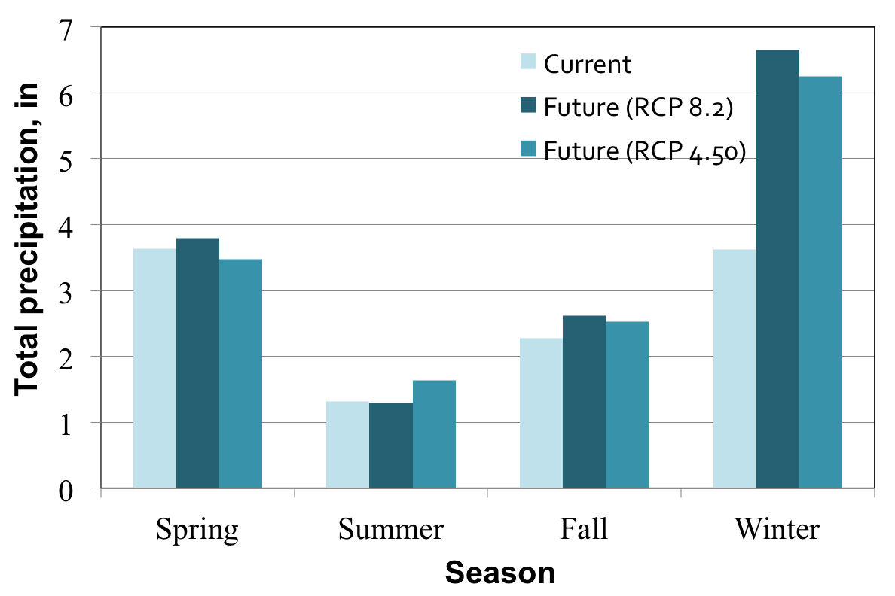
Jerome, ID – Precipitation

Slide 43
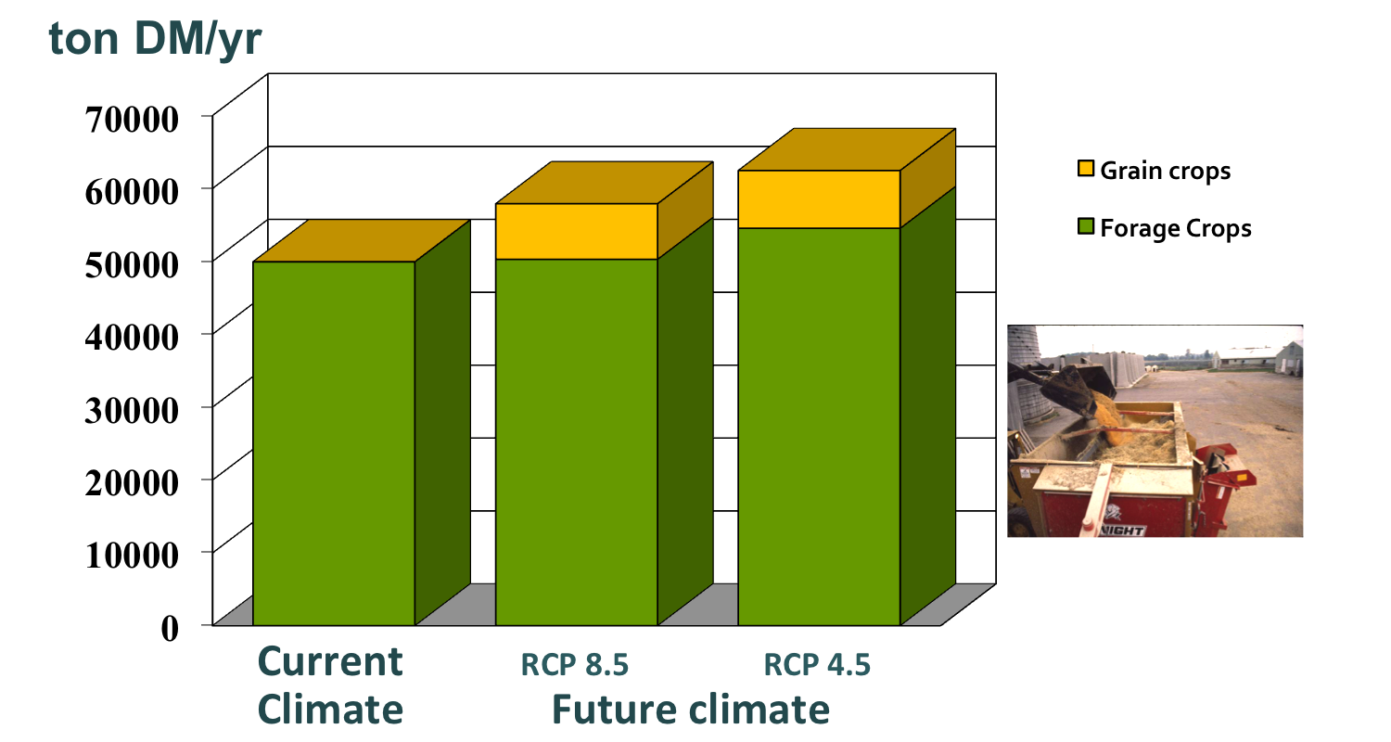
Jerome, ID – Feed Production

Slide 44
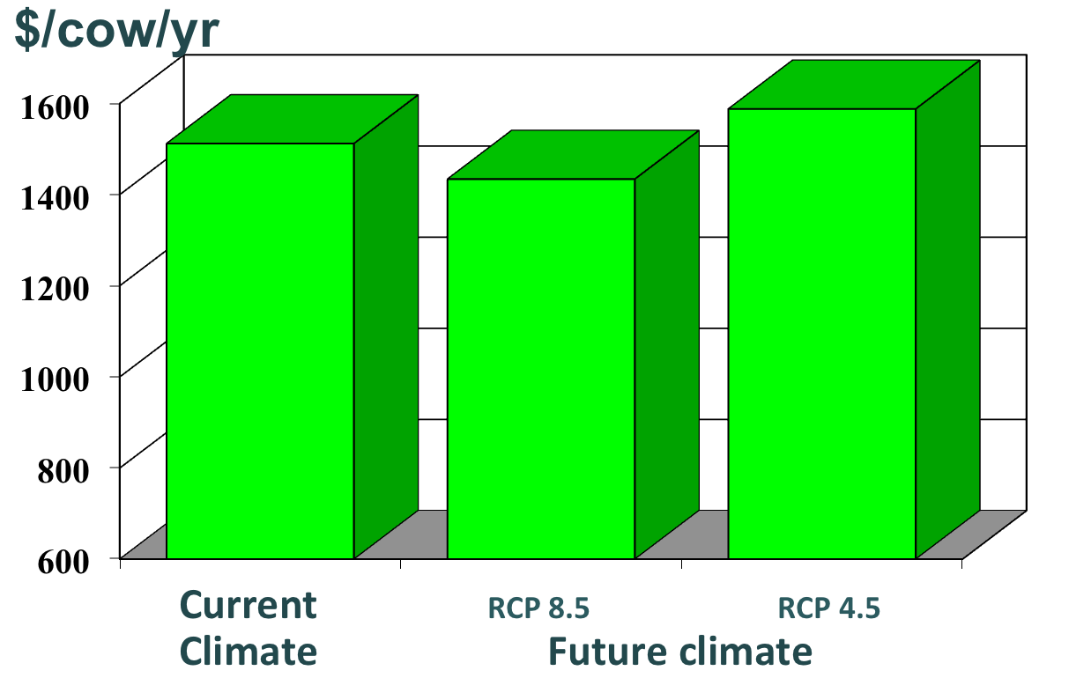
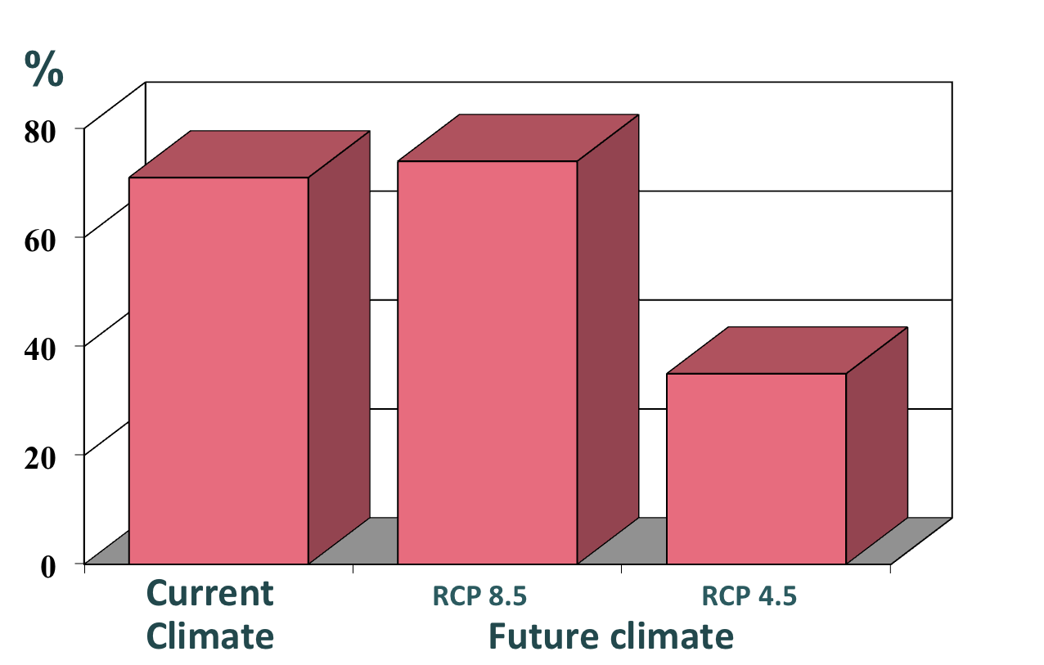
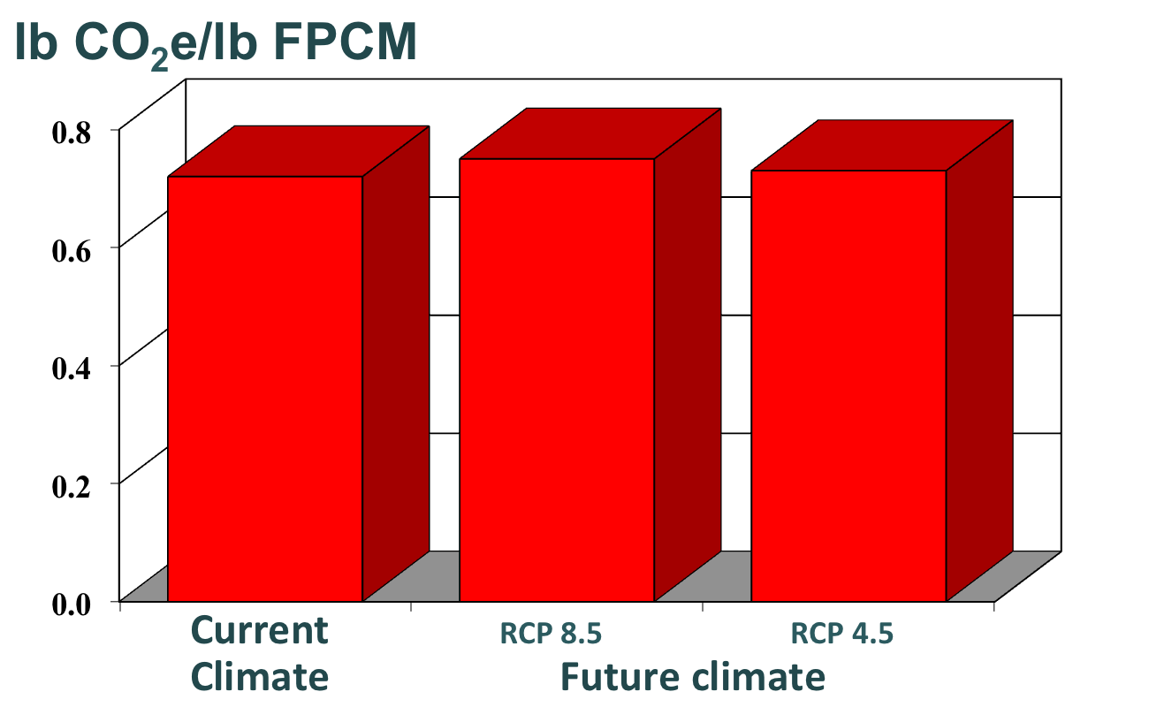
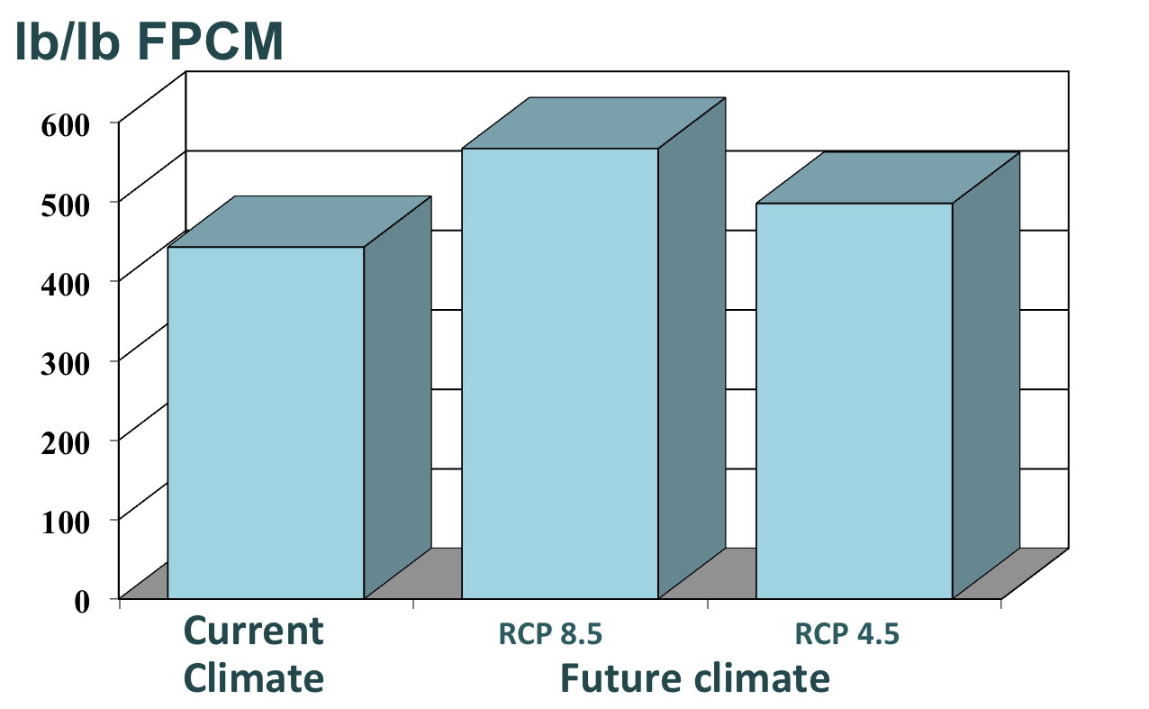
Jerome, ID – Results
NET RETURN
NET RISK
CARBON FOOTPRINT
WATER
FOOTPRINT

Slide 45
Farm Simulation – Overall Results
Forage production may benefit from climate change as long as adequate water is available
Higher temperatures and changes in precipitation patterns will increase gaseous emissions and nutrient losses
Adaptations in management can often maintain farm profitability

Slide 46
CONCLUSIONS
Local climate studies and assessments can provide crucial information in building resilience, preparing to adapt, and even mitigating future emissions.
In many sectors, downscaled climate projections can be used to assess quantifiable local impacts of climate change
  Here I showed examples from infrastructure and agriculture
  But the possibilities are many

Slide 47
KEY INFORMATION TO TAKE AWAY
Regional and sectoral impact assessments can be based on this step-by-step procedure:
  Understand and quantify historical and current vulnerabilities to climate and weather risks
  Assess the extent to which quantitative projections can be developed to inform how this risk may change in the future
  Assemble data and information (historical events, future projections)
  Calculate indices or use projections as input to an impact or risk assessment model that is already being used in this area (e.g. a water availability model, a crop yield production model, etc.)

Slide 48
THANK YOU!
Collaborators:
Katharine Hayhoe, TTU
Heather Miller, UMASS
Jennifer Jacobs, UNH
Jo Daniel, UNH
Al Rotz, USDA
Howard Skinner, USDA

